Slide 1
AtliQ Hospitality Analysis
Unified Mentor | Vishwa Sagar

Slide 2
Project analysis slide 2
Agenda
4. ANALYSIS
1. ASK
PROJECT
5. SHARE
2. PREPARE
6. ACT
3. PROCESS

Slide 3
Project analysis slide 3
Data Overview
COMPANY
TECHNICAL ANALYSIS
FINANCIAL ANALYSIS
ECONOMIC ANALYSIS
ECOLOGICAL ANALYSIS
AtliQ Grands owns multiple five-star hotels across India. They have been in the hospitality industry for the past 20 years. Founded in 2017, AtliQ emerged as an IT & Business Consulting Company.
AtliQ Bay
AtliQ Blu
AtliQ City
AtliQ Exotica
AtliQ Grands
AtliQ Palace
AtliQ Seasons
Hyderabad
Bangalore
Delhi
Mumbai
Business
Luxxury
Standard
Elite
Premium
Presedential
Direct Offline
Direct Online
Journey
LogTrip
MakeYourTrip
Tripster
Other

Slide 4
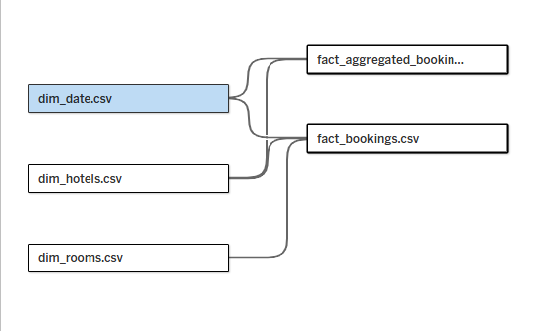
Project analysis slide 4
Data Model

Slide 5
Project analysis slide 6
Key Performance Indicators
RevPAR (Revenue Per Available Room) = Total Revenue/Total Rooms Available to Sell.
ADR (Average Daily Rate) = Total Rooms Available/No. of Rooms Sold..
Occupancy = Total Rooms Occupied/Total Rooms Available
RevPAR
ADR
Occupancy
Realization
Cancellation
Average Rating
Realization = Daily Utilized Room Nights / Daily Sellable Room Nights.
Cancellation = Bookings Cancelled / Bookings made.
Average Ratings = SUM(Ratings Given / No. of Ratings Given)

Slide 6
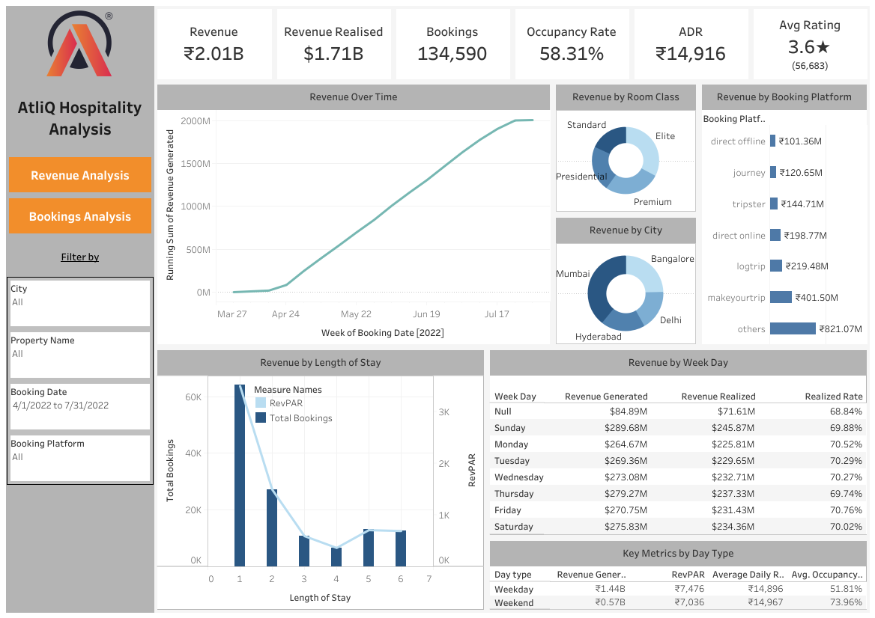
Project analysis slide 7
Dashboards
Revenue Analysis Dashboard

Slide 7
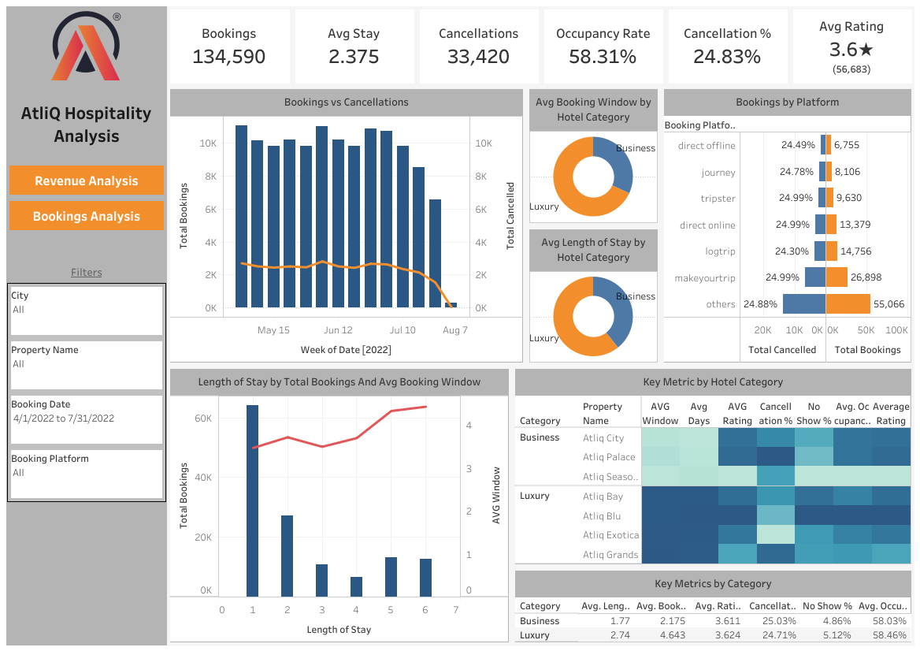
Dashboards
Bookings Analysis Dashboard

Slide 8
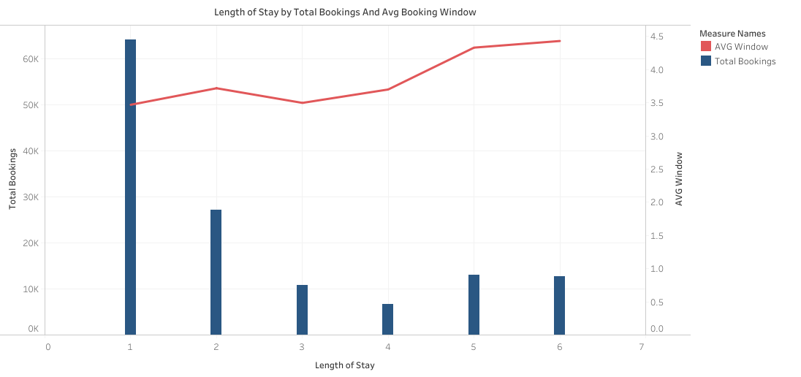
Project analysis slide 8
Insights
Most bookings are for short stays, with a significant majority being for one day (64,066 bookings). Longer stays, particularly those exceeding four days, are less common (up to 13,083 bookings).
Generally, longer stays are associated with longer booking windows. However, there may be exceptions, such as last-minute bookings for extended stays.
Longer stays tend to be less frequent compared to shorter stays. This is likely due to factors like vacation preferences and budget constraints.

Slide 9
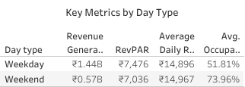
Insights
During weekdays, the revenue total is ₹1.44B.
Occupancy Rate stands at 51.81%, with an Average Daily Rate of ₹14,097 and Revenue per Available Room of ₹7,476 on weekdays.
The weekends see a revenue of ₹57M, with ₹7,036 as the Revenue per Available Room.
Occupancy Rate increases to 73.96% accompanied by a slightly higher ADR of ₹14,967.

Slide 10
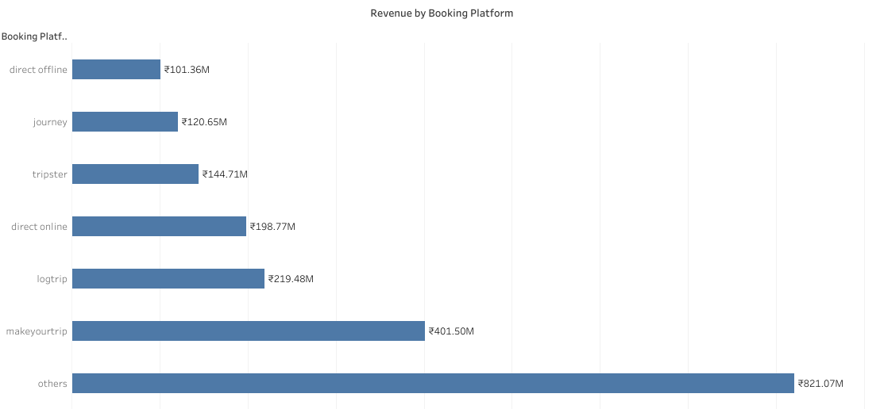
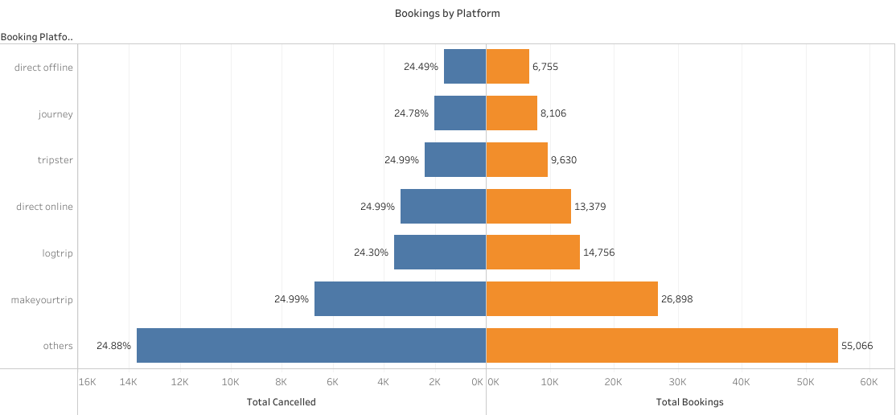
Project analysis slide 10
Project Analysis
Direct offline bookings indicate a lower count and lower revenue generated. Whereas, bookings through other platforms showcase higher bookings numbers, and therefore, higher revenue generated.
Notably, bookings via MakeYouTrip accounts for 20% of the revenue and 19.99% of the total bookings.
The cancellation rate remains around 24-25% of total bookings made.

Slide 11
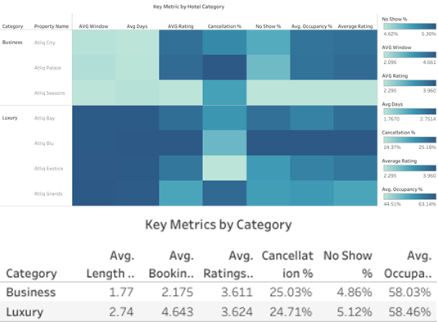

Slide 12
Business Hotels
Lower Average Length of Stay: 1.77 days.
Lower Average Booking Window: 2.175 days.
Lower Average Ratings: 3.611.
Higher Cancellation Rates: 25.03%.
Lower No-Show Rates: 4.86%.
Lower Occupancy Rates: 58.03%.
Luxury Hotels
Higher Average Length of Stay: 2.74 days.
Higher Average Booking Window: 4.643 days.
Higher Average Ratings: 3.611.
Lower Cancellation Rates: 24.71%.
Higher No-Show Rates: 5.12%.
Higher Occupancy Rates: 58.46%.

Slide 13
Thank You

